Slide 1

uNit 3 – Management
Computing Systems

Slide 2
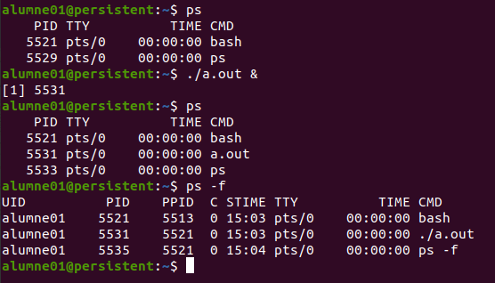
Introduction
MultiTask vs MonoTask and MultiUser vs MonoUser
Program is a list of instructions.
Program become a process in OS.
Process is an execution program.
Run more than one process needs parallelism.
Each Process is the only one that runs. Is possible run more simultaneously with more CPUs.
Process Control Block(PCB)
Process ID
Process State
Program Counter
Registers
CPU Scheduling information
Memory Management information
Accounting information
I/O Status information
ps (process status)
PID | Process ID
TTY | Associated terminal or ?
TIME | Total time CPU used
CMD | Process name
UID | User name
PPID | PID parent
C | % CPU resources used
STIME | Process start time

Slide 3
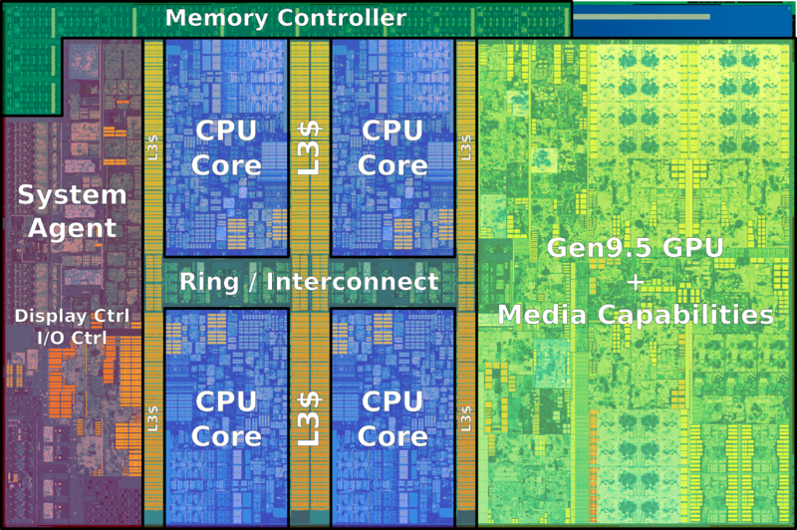
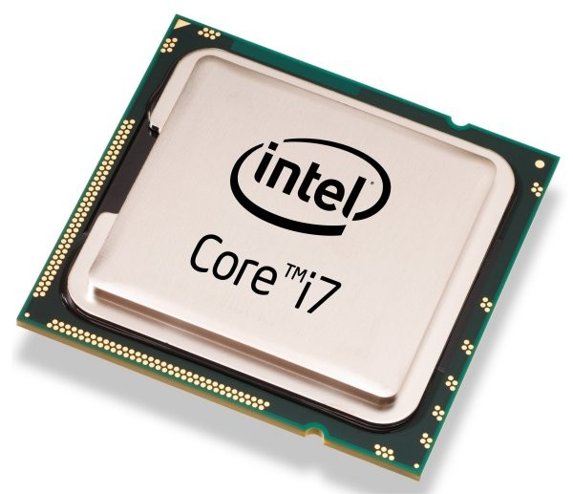
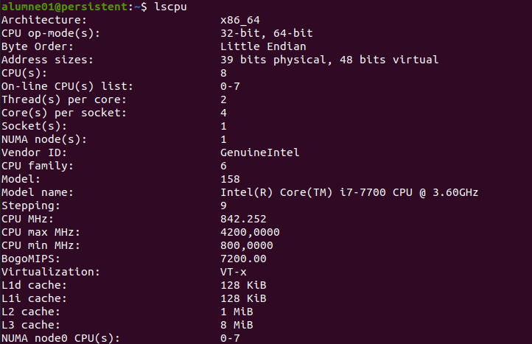
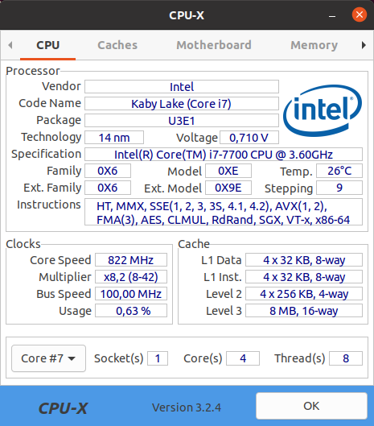
How many processes in parallel?
Parallelism depends on Cores
The Socket is a container on put a microchip.
In one microchip are some cores, memory and more.
Each core has at least one Thread.
CPU means CPU not Core.
Thread is Basic unit of use.
Has his Program Counter.
Has his CPU Registers.
Has Stack space.
Has a State.
In the same App Thread share:
PaCode(Instructions).
Global Variables.
Open Files and Devices.
Font:https://en.wikichip.org/
Graphics processing unit (GPU)
Some microchip includes a GPU for graphics with lots of special cores.
https://www.youtube.com/watch?v=-P28LKWTzrI

Slide 4
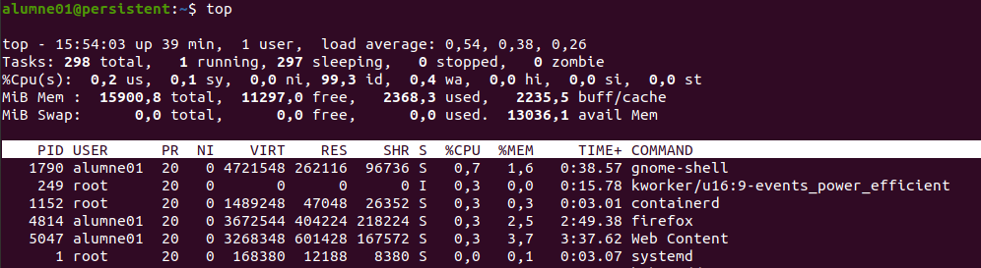
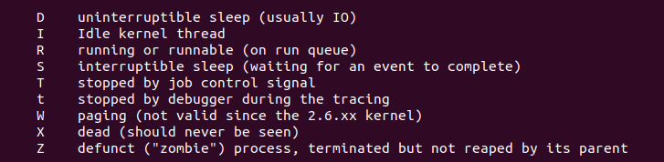
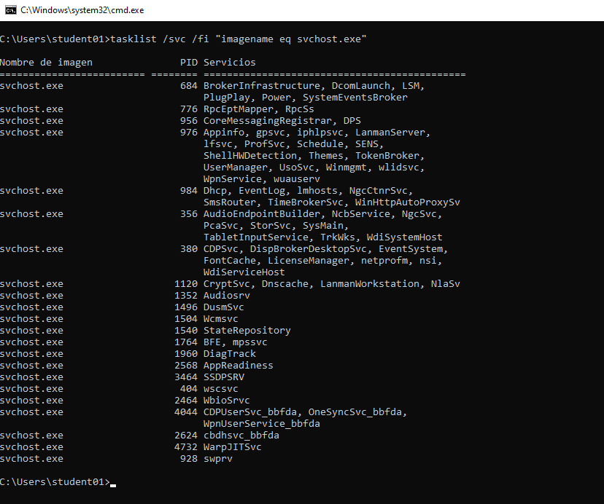
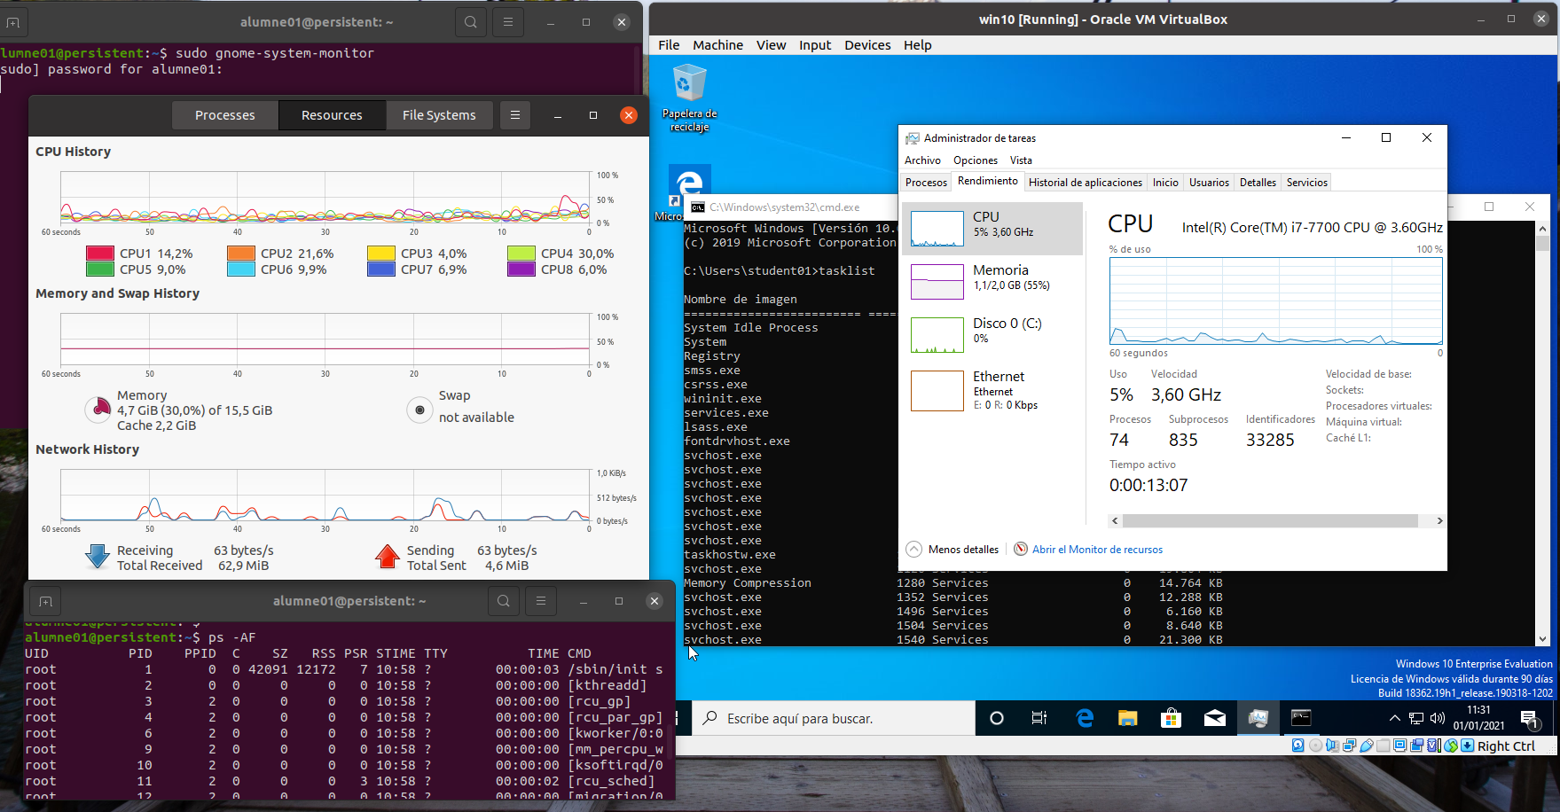
Monitoring Processes
Daemons or Services
Process states:
User mode.
Kernel mode.
Waiting.
Sleeping.
Runnable.
Virtual memory.
New process.
Zombie.
Check command with man ps
Look for BSB with /BSD
move over results with n or shift+n

Slide 5
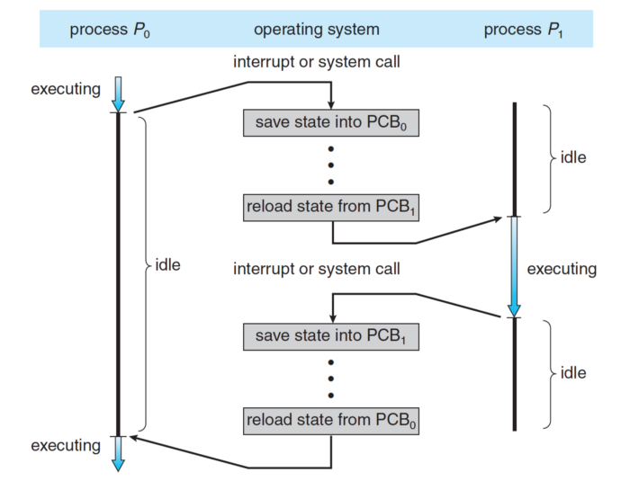
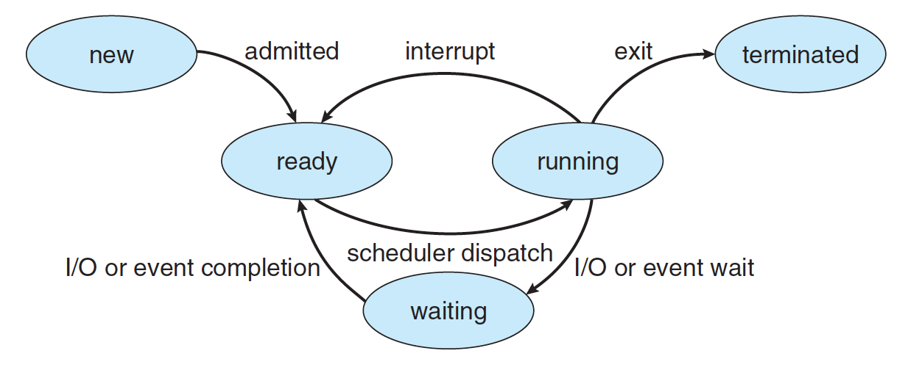
Scheduler
The Dispatcher assign CPU to a process.
It means executing a context change.
The Scheduler determines the running process at all times.
Policy is defined by:
Selection of the process to be executed
Priorities with or without expulsive policy. To avoid starvation combine with increase priority over time.
First come First Served (FCFS). It’s a simple FIFO cue.
Shortest Remaining Time First (SRTF) or Shortest Job First (SJF) without expulsive policy.
When planning is done
No expulsive policy:
Wait for it to crash and release the CPU
With expulsive policy:
Event oriented. Real-Time Systems.
Time shared. Round-Robin.
Font:https://medium.com/@kiyoungju

Slide 6
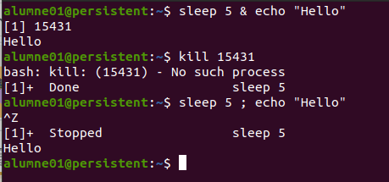
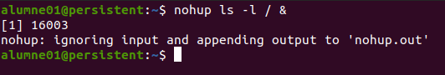
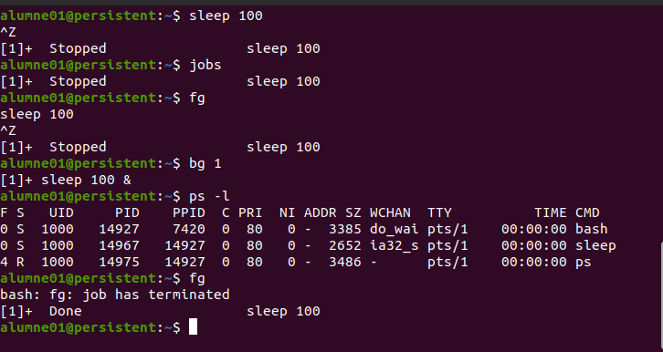
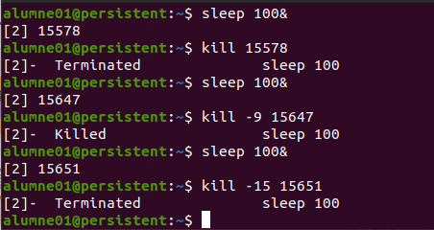
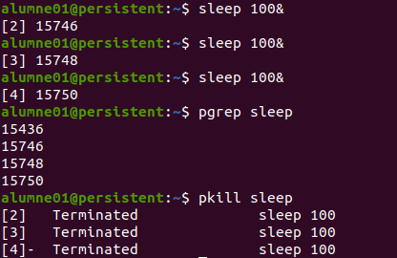
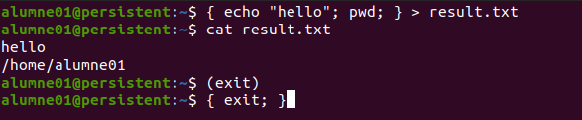
Processes management
Ampersand &, background, foreground, nohup, kill and jobs.
kill [PID]
1(SIGHUP) | Parent send it when finish
2(SIGINT) | Interruption Ctrl+C
3(SIGQUIT) | Idem SIGINT with core Dump
9(SIGKILL) | Force process to end
15(SIGTERM) | Request process to finish
Shell or SubShell with { <command>; } or (<command>)

Slide 7
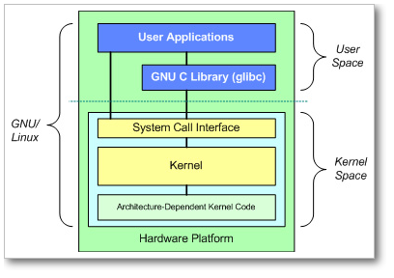
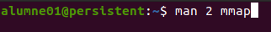
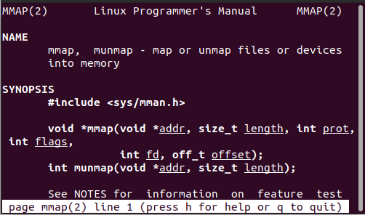
System calls library
System calls allow access to SO services: open, read, fork, mmap, kill, time, etc.
GLIBC takes care of hiding interface details from kernel system calls in the form of C functions.
These functions transfer the parameters they receive, normally through the stack, in the registers of the appropriate processor, they invoke the SO.
All system calls are documented in section 2 of the UNIX manual:
Font:http://sop.upv.es/gii-dso/es/

Slide 8
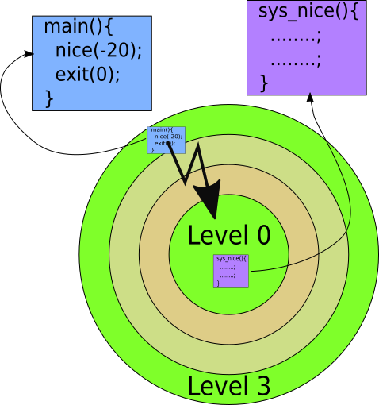
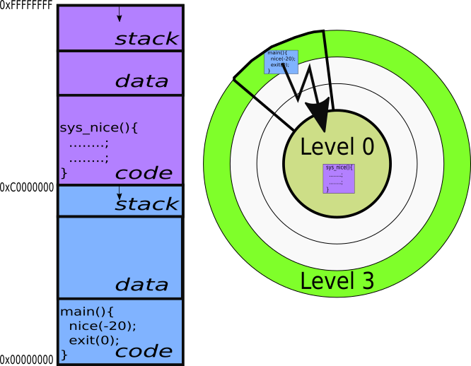
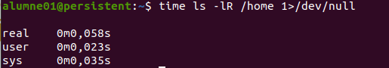
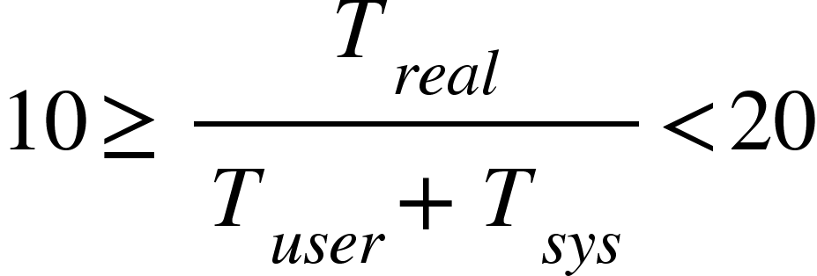
nice for init command and renice to change priority of started process.
nice <Priority> <command>
<Priority> [-20, 20] for authorized and [0, 20] other users.
renice <-n Priority> [-p] [-g] [-u] ID
-n
-p
-g
-u
<Priority> [-20, 20] for authorized and [0, 20] other users.
<PID>
<GID>
<UID>
Performance with command time
Stderr 2
time <command + options + arg>
real | Total time duration
user | Total CPU time needed
sys | Total system calls CPU time needed

Slide 9
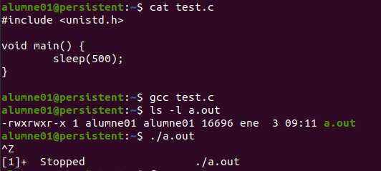
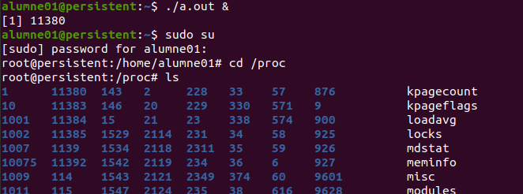
Linux Kernel is written in C
https://github.com/torvalds/linux/blob/master/init/main.c
GPL programs offer us their source files
Code font in files .c .h or .cpp
A special file Makefile can automate de compilation.
A file .configure can generate the special file Makefile.
To compile a product is mandatory:
The tool make installed.
The compilers needed in special gcc.
The libraries needed, interpreters etc.
Is possible disassemble object code with objdump -d a.out

Slide 10
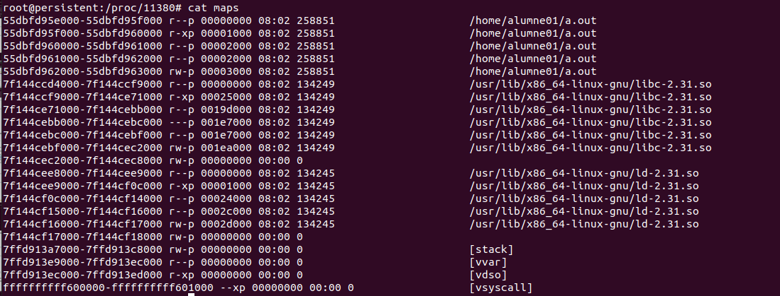
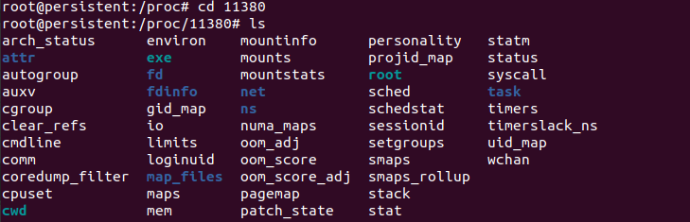
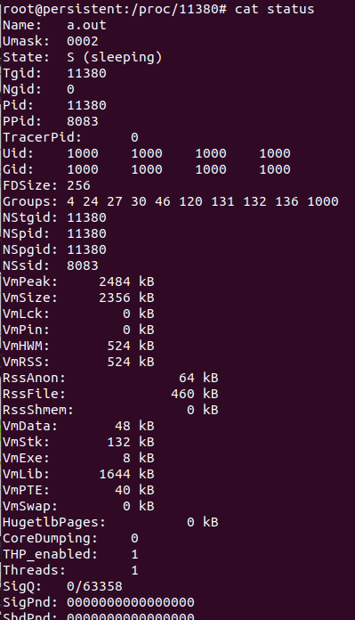
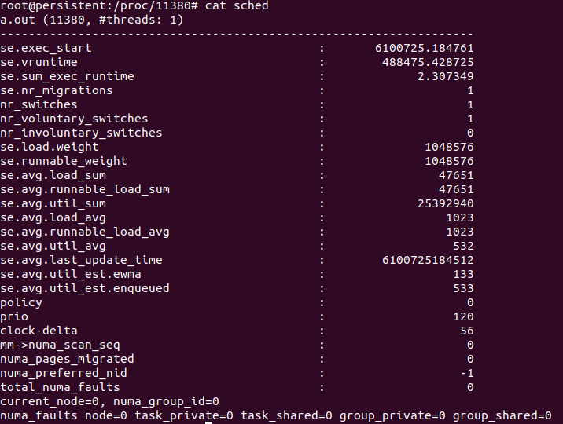

Slide 11
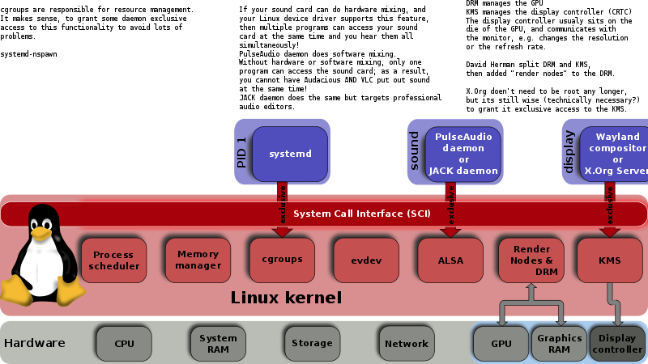
Systemd wins init System V and upstart
Systemd means System Daemon and is an alternative to classical init
Systemd is the first process, PID=1.
It allows to accelerate the start of services. First PID user around 1800.
Invocations to API functions such cgroups only inside linux kernel so is not portable and POSIX compatible.
Execution levels only for compatibility with System V now is target unit.
A target is the synchronization
point between standby units.
One target can be others targets.
Graphical environment.
Network services.
Audio services.
etc.
Font:https://en.wikipedia.org/wiki/Cgroups

Slide 12
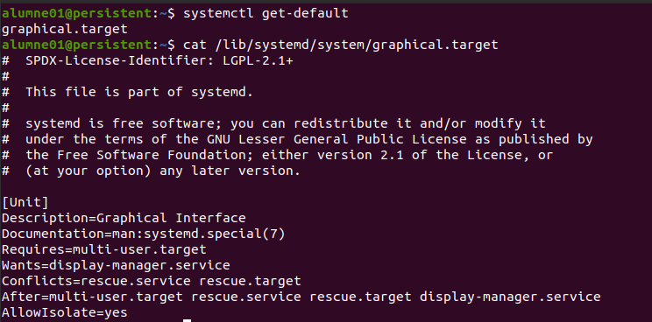
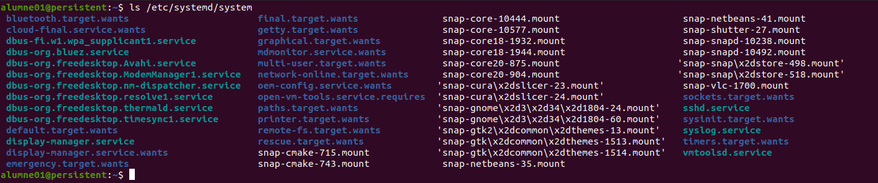
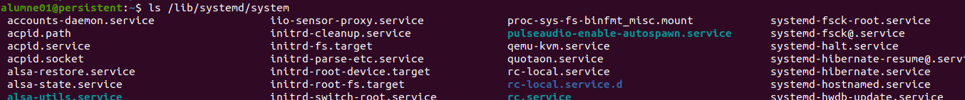
Systemd has a basic component called Unit:
Services.
Sockets.
Peripherals.
Targets, etc.
Target units or managed services while starting
Definitions about units

Slide 13
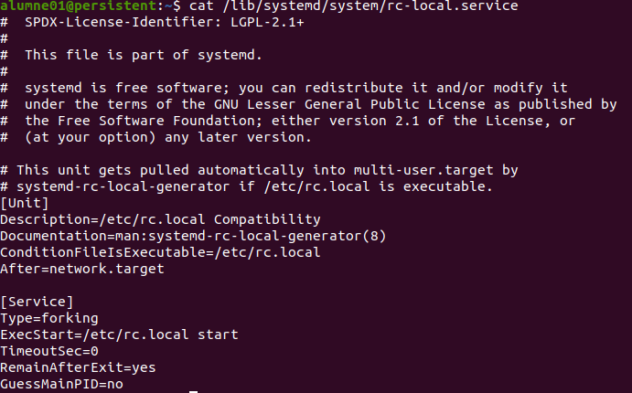
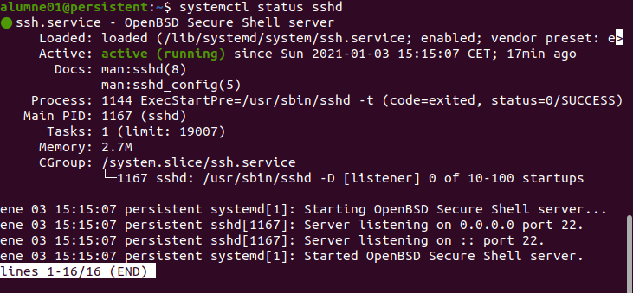
Services has sufix .service and are text files.
Text files describe the rules and commands related to the service.
service | systemctl | Description
service <name> start | systemctl start <name> | Start service
service <name> stop | systemctl stop <name> | Stop service
service <name> restart | systemctl restart <name> | Restart service
service <name> condrestart | systemctl try-restart <name> | Restart service if is active
service <name> reload | systemctl reload <name> | Reload configuration
service <name> statut | systemctl status <name> | Shows if service is active
service --status-all | systemctl list-units | Shows all services state

Slide 14
To finish....
Thanks!

